Slide 1
OPENACC ONLINE COURSE
Lecture 2: GPU Programming with OpenACC
John Urbanic, Pittsburgh Supercomputing Center
October 26, 2017

Slide 2
Course Syllabus:
October 19: Introduction to OpenACC
October 26: GPU Programming with OpenACC
November 2: Optimizing and Best Practices for OpenACC
Questions? Email openacc@nvidia.com

Slide 3
Homework solution

Slide 4

Exercise 1: C Solution
while ( dt > MAX_TEMP_ERROR && iteration <= max_iterations ) {
#pragma acc kernels
for(i = 1; i <= ROWS; i++) {
for(j = 1; j <= COLUMNS; j++) {
Temperature[i][j] = 0.25 * (Temperature_last[i+1][j] + Temperature_last[i-1][j] +
Temperature_last[i][j+1] + Temperature_last[i][j-1]);
}
}
dt = 0.0; // reset largest temperature change
#pragma acc kernels
{
for(i = 1; i <= ROWS; i++){
for(j = 1; j <= COLUMNS; j++){
dt = fmax( fabs(Temperature[i][j]-Temperature_last[i][j]), dt);
Temperature_last[i][j] = Temperature[i][j];
}
}
}
if((iteration % 100) == 0) {
track_progress(iteration);
}
iteration++;
}
Generate a parallel Kernel
Generate a parallel Kernel

Slide 5
Exercise 1: Fortran Solution
do while ( dt > max_temp_error .and. iteration <= max_iterations)
!$acc kernels
do j=1,columns
do i=1,rows
temperature(i,j)=0.25*(temperature_last(i+1,j)+temperature_last(i-1,j)+ &
temperature_last(i,j+1)+temperature_last(i,j-1) )
enddo
enddo
!$acc end kernels
dt=0.0
!$acc kernels
do j=1,columns
do i=1,rows
dt = max( abs(temperature(i,j) - temperature_last(i,j)), dt )
temperature_last(i,j) = temperature(i,j)
enddo
enddo
!$acc end kernels
if( mod(iteration,100).eq.0 ) then
call track_progress(temperature, iteration)
endif
iteration = iteration+1
enddo
Generate a parallel Kernel
Generate a parallel Kernel

Slide 6
CPU Performance
3372 steps to convergence

Slide 7
Moving to the GPU
Change the target accelerator flag from “-ta=multicore” to “-ta=tesla”
% pgcc -acc -ta=tesla -Minfo=accel –DMAX_ITER=4000 laplace_kernels.c –o laplace.out
main:
65, Generating implicit copyin(Temperature_last[:][:])
Generating implicit copyout(Temperature[1:1000][1:1000])
66, Loop is parallelizable
67, Loop is parallelizable
Accelerator kernel generated
Generating Tesla code
66, #pragma acc loop gang, vector(4) /* blockIdx.y threadIdx.y */
67, #pragma acc loop gang, vector(32) /* blockIdx.x threadIdx.x */
76, Generating implicit copyin(Temperature[1:1000][1:1000])
Generating implicit copy(Temperature_last[1:1000][1:1000])
77, Loop is parallelizable
78, Loop is parallelizable
Accelerator kernel generated
Generating Tesla code
77, #pragma acc loop gang, vector(4) /* blockIdx.y threadIdx.y */
78, #pragma acc loop gang, vector(32) /* blockIdx.x threadIdx.x */
79, Generating implicit reduction(max:dt)

Slide 8
Running on the GPU
  % ./laplace.out
  …
  ---------- Iteration number: 3100 ------------
  [995,995]: 97.58 [996,996]: 98.18 [997,997]: 98.71 [998,998]: 99.17 [999,999]: 99.55 [1000,1000]: 99.86
  ---------- Iteration number: 3200 ------------
  [995,995]: 97.62 [996,996]: 98.21 [997,997]: 98.73 [998,998]: 99.18 [999,999]: 99.56 [1000,1000]: 99.86
  ---------- Iteration number: 3300 ------------
  [995,995]: 97.66 [996,996]: 98.24 [997,997]: 98.75 [998,998]: 99.19 [999,999]: 99.56 [1000,1000]: 99.87
  Max error at iteration 3372 was 0.009995
  Total time was 40.462415 seconds.
Our time slows down by almost 7x from the original serial version of the code!

Slide 9
What went wrong?
% pgprof –cpu-profiling-mode top-down ./laplace.out
….
==455== Profiling result:
Time(%) Time Calls Avg Min Max Name
57.41% 13.2519s 13488 982.49us 959ns 1.3721ms [CUDA memcpy HtoD]
36.08% 8.32932s 10116 823.38us 2.6230us 1.5129ms [CUDA memcpy DtoH]
3.42% 788.42ms 3372 233.81us 231.79us 235.79us main_80_gpu
2.80% 646.58ms 3372 191.75us 189.69us 194.04us main_69_gpu
0.29% 66.916ms 3372 19.844us 19.519us 20.223us main_81_gpu_red
======== CPU profiling result (top down):
Time(%) Time Name
…
9.15% 16.3609s | __pgi_uacc_dataexitdone
9.11% 16.2809s | __pgi_uacc_dataonb
…
13.2 seconds copying data from host to device
8.3 seconds copying data from device to host
Including the copy, there is an additional CPU overhead needed to create and delete the device data

Slide 10
Architecture
Basic Concept
Simplified, but sadly true
CPU
GPU
$
$
$
$
$
$
$
$
$
$
$
$
Shared Cache
$
$
$
$
$
$
$
$
High Capacity Memory
Shared Cache
PCIe Bus
High Bandwidth Memory

Slide 11

Multiple Times Each Iteration
Excessive Data Transfers
CPU Memory
GPU Memory
A(i+1,j)
A(i+1,j)
PCIe Bus
A(i-1,j)
A(i,j)
A(i+1,j)
A(i-1,j)
A(i,j)
A(i+1,j)
A(i+1,j)
A(i,j-1)
A(i,j-1)
A(i-1,j)
A(i,j)
A(i+1,j)
A(i,j-1)
CPU
GPU

Slide 12
Excessive Data Transfers
while ( dt > MAX_TEMP_ERROR && iteration <= max_iterations ) {
Temperature, Temperature_old resident on host
Temperature, Temperature_old resident on device
#pragma acc kernels
for(i = 1; i <= ROWS; i++) {
for(j = 1; j <= COLUMNS; j++) {
Temperature[i][j] = 0.25 * (Temperature_old[i+1][j] + …
}
}
Temperature, Temperature_old resident on device
Temperature, Temperature_old resident on host
4 copies happen every iteration of the outer while loop!
dt = 0.0;
Temperature, Temperature_old resident on host
Temperature, Temperature_old resident on device
#pragma acc kernels
for(i = 1; i <= ROWS; i++) {
for(j = 1; j <= COLUMNS; j++) {
Temperature[i][j] = 0.25 * (Temperature_old[i+1][j] + …
}
}
Temperature, Temperature_old resident on host
Temperature, Temperature_old resident on device
}

Slide 13
Data Management
The First, Most Important, and Possibly Only OpenACC Optimization

Slide 14
Data Construct Syntax and Scope
C
#pragma acc data [clause …]
{
structured block
}
Fortran
!$acc data [clause …]
structured block
!$acc end data

Slide 15
Data Clauses
copy( list ) Allocates memory on GPU and copies data from host to GPU when entering region and copies data to the host when exiting region.
Principal use: For many important data structures in your code, this is a logical default to input, modify and return the data.
copyin( list ) Allocates memory on GPU and copies data from host to GPU when entering region.
Principal use: Think of this like an array that you would use as just an input to a subroutine.
copyout( list ) Allocates memory on GPU and copies data to the host when exiting region.
Principal use: A result that isn’t overwriting the input data structure.
create( list ) Allocates memory on GPU but does not copy.
Principal use: Temporary arrays.

Slide 16
Array Shaping
Compilers sometimes cannot determine the size of arrays, so we must specify explicitly using data clauses with an array “shape”. The compiler will let you know if you need to do this. Sometimes, you will want to for your own efficiency reasons.
C
#pragma acc data copyin(a[0:count]), copyout(b[s/4:3*s/4])
Fortran
!$acc data copyin(a(1:end)), copyout(b(s/4:3*s/4))
Fortran uses start:end and C uses start:count
Data clauses can be used on data, kernels or parallel

Slide 17
Compiler will (increasingly) often make a good guess…
C Code
Compiler Output
int main(int argc, char *argv[]) {
int i;
double A[2000], B[1000], C[1000];
#pragma acc kernels
for (i=0; i<1000; i++){
A[i] = 4 * i;
B[i] = B[i] + 2;
C[i] = A[i] + 2 * B[i];
}
}
pgcc -acc -Minfo=accel loops.c
main:
6, Generating implicit copy(B[:])
Generating implicit copyout(C[:])
Generating implicit copyout(A[:1000])
7, Loop is parallelizable
Accelerator kernel generated
Generating Tesla code
7, #pragma acc loop gang, vector(128)
Smarter
Smart
Smartest

Slide 18
Data Regions Have Real Consequences
Simplest Kernel
With Global Data Region
  int main(int argc, char** argv){
  float A[1000];
  #pragma acc kernels
  for( int iter = 1; iter < 1000 ; iter++){
  A[iter] = 1.0;
  }
  A[10] = 2.0;
  printf("A[10] = %f", A[10]);
  }
  int main(int argc, char** argv){
  float A[1000];
  #pragma acc kernels
  for( int iter = 1; iter < 1000 ; iter++){
  A[iter] = 1.0;
  }
  A[10] = 2.0;
  printf("A[10] = %f", A[10]);
  }
A[ ]
Copied
To GPU
A[ ]
Copied
To GPU
#pragma acc data copy(A)
{
A[ ]
Copied
To Host
Still
Runs On
Host
Runs
On
Host
}
A[ ]
Copied
To Host
Output:
A[10] = 2.0
Output:
A[10] = 1.0

Slide 19
Data Regions vs. Compute Regions
  int main(int argc, char** argv){
  float A[1000];
  #pragma acc kernels
  for( int iter = 1; iter < 1000 ; iter++){
  A[iter] = 1.0;
  }
  A[10] = 2.0;
  printf("A[10] = %f", A[10]);
  }
#pragma acc data copy(A)
{
Compute
Region
Data
Region
}
Output:
A[10] = 1.0

Slide 20
Data Movement Decisions
Much like loop data dependencies, sometime the compiler needs your human intelligence to make high-level decisions about data movement. Otherwise, it must remain conservative – sometimes at great cost.
You must think about when data truly needs to migrate, and see if that is better than the default.
Besides the scope-based data clauses, there are OpenACC options to let us manage data movement more intensely or asynchronously. We could manage the above behavior with the update construct:
C Fortran
#pragma acc update [self(), device(), …] !$acc update [self(), device(), …]
Ex: #pragma acc update self(Temp_array) //Get host a copy from device

Slide 21
Analyzing / Profiling

Slide 22
OpenACC Development Cycle
Analyze
Analyze your code, and predict where potential parallelism can be uncovered. Use profiler to help understand what is happening in the code and were parallelism may exist
Parallelize your code, starting with the most time consuming parts. Focus on maintaining correct results from your program
Optimize your code, focusing on maximizing performance. Performance may not increase all-at-once during early parallelization
Analyze
Optimize
Parallelize
Notes:
This is the OpenACC development cycle. Analyze -> Parallelize -> Optimize. Rinse and repeat. It is slightly over-simplified, however. It is very important to profile you code before beginning, however, it is equally important to continue profiling your code as you make changes. It is important to verify that changes you are making are impacting the code in a way that you expected.
The Modules are designed to follow this format. This Module will include the Analyze portion. We are expecting students to profile for every module, however.

Slide 23
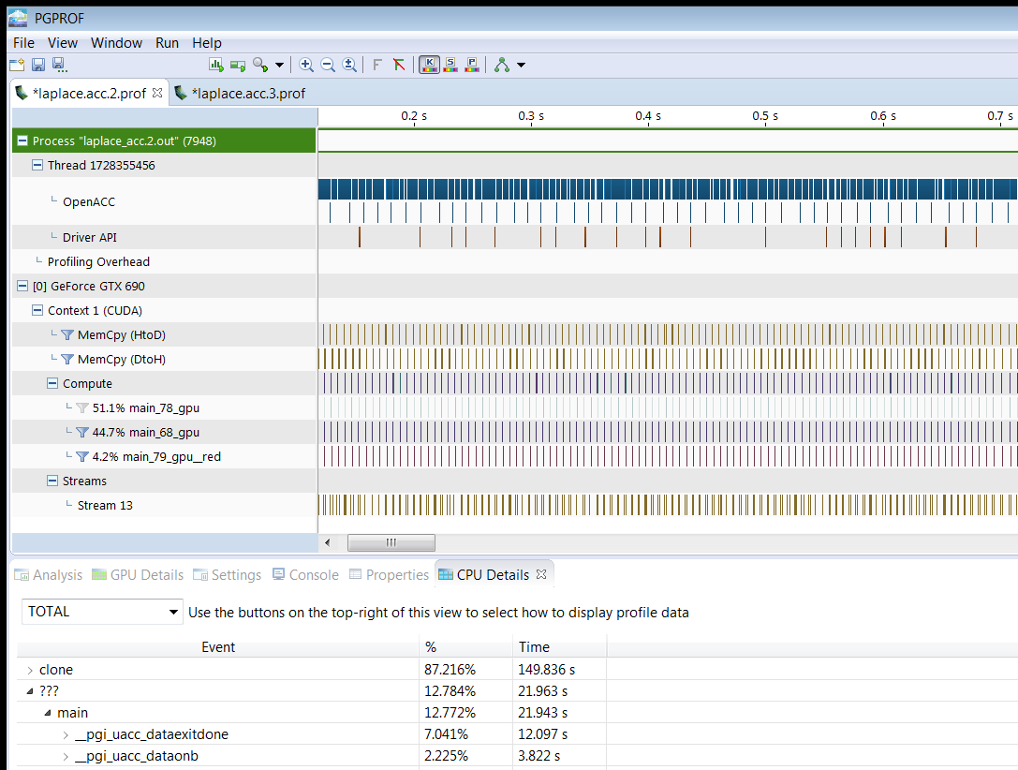
Profiling gpu code
Using PGPROF to profile GPU code
This is the view of PGPROF after profiling a GPU application
The first obvious difference when compared to our command line profile: a visual timeline of events

Slide 24
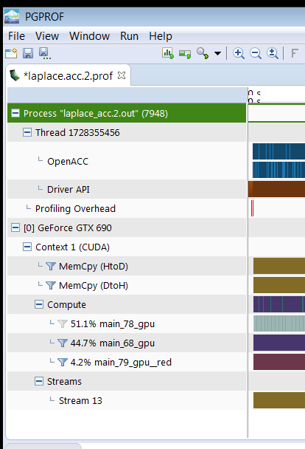
Profiling gpu code
Using PGPROF to profile GPU code
MemCpy(HtoD): This includes data transfers from the Host to the Device (CPU to GPU)
MemCpy(DtoH): These are data transfers from the Device to the Host (GPU to CPU)
Compute: These are our computational functions.

Slide 25
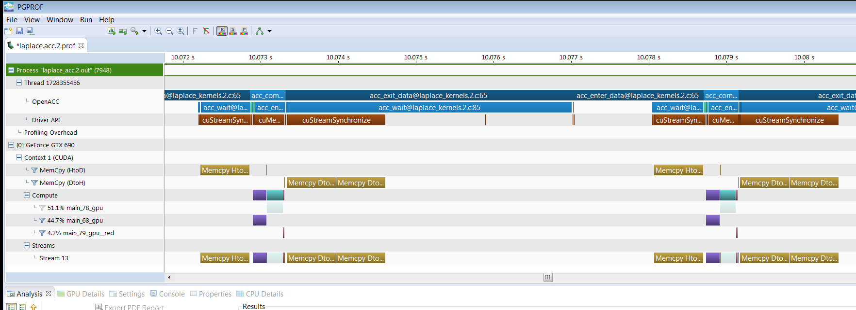
Inspecting the PGPROF Timeline
Zooming in gives us a better view of the timeline. It looks like our program is spending a significant amount of time transferring data between the host and device. We also see that the compute regions are very small, with a lot of distance between them.
Device Memory Transfers
Compute on the Device
CPU overhead time including:
- Device data creation and deletion
- Virtual to Physical Host Memory Copy
* Note we use a 1 kernel solution (available from the Resources console)

Slide 26
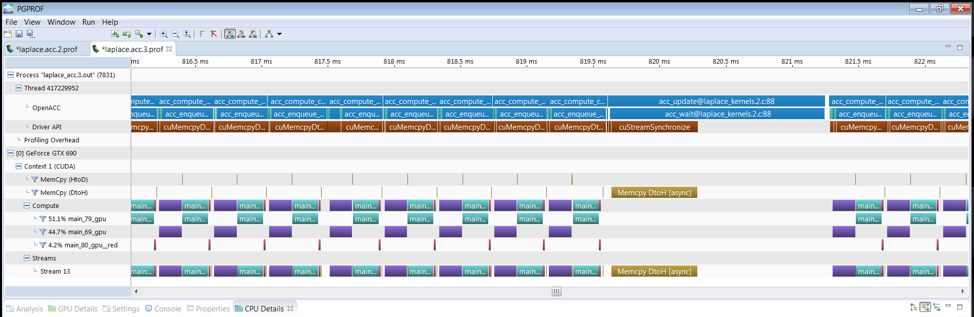
PROFILE after adding a data region
After adding a data region, we see lots of compute and data movement only when we update.
Device compute
Update to host
Pinned to Virtual Host memory copy

Slide 27
Exercise 2
Use acc data to minimize transfers
Q: What speedup can you get with data + kernels directives?
Start with your Exercise 1 solution (or ours).
  Add data directives where it helps.
    Think: when should I move data between host and GPU? Think how you would do it by hand, then determine which data clauses will implement that plan.
    Hint: you may find it helpful to ignore the output at first and just concentrate on getting the solution to converge quickly (at 3372 steps). Then worry about updating the printout (hint, hint).

Slide 28

Exercises: General Instructions
The exercise is found at https://nvlabs.qwiklab.com
  Create an account or log in (use the same email you registered for the course with)
  Open class: OpenACC Course Oct 2017

Slide 29
TODAY WE DISCUSSED
What OpenACC data directives are
Why they are important for GPU use
How to spot these, and many other types of performance hotspots, with a Profiler
Questions? Email openacc@nvidia.com

Slide 30







OPENACC Resources
Guides ● Talks ● Tutorials ● Videos ● Books ● Spec ● Code Samples ● Teaching Materials ● Events ● Success Stories ● Courses ● Slack ● Stack Overflow
Resources
https://www.openacc.org/resources
Success Stories https://www.openacc.org/success-stories
FREE
Compilers
Compilers and Tools https://www.openacc.org/tools
Events
https://www.openacc.org/events
https://www.openacc.org/community#slack

Slide 31




OpenACC for Everyone
DOWNLOAD
https://www.pgroup.com/products/community.htm
New PGI Community Edition Now Available
FREE
PROGRAMMING MODELS OpenACC, CUDA Fortran, OpenMP, C/C++/Fortran Compilers and Tools
PLATFORMS X86, OpenPOWER, NVIDIA GPU
UPDATES | 1-2 times a year | 6-9 times a year | 6-9 times a year
SUPPORT | User Forums | PGI Support | PGI Professional Services
LICENSE | Annual | Perpetual | Volume/Site

Slide 32


New Book: OpenACC for Programmers
Edited by: By Sunita Chandrasekaran, Guido Juckeland
Discover how OpenACC makes scalable parallel programming easier and more practical
Get productive with OpenACC code editors, compilers, debuggers, and performance analysis tools
Build your first real-world OpenACC programs
Overcome common performance, portability, and interoperability challenges
Efficiently distribute tasks across multiple processors
READ MORE
http://www.informit.com/store/openacc-for-programmers-concepts-and-strategies-9780134694283
Use code OPENACC during checkout for 35% off
*Discount taken off list price. Offer only good at informit.com

Slide 33

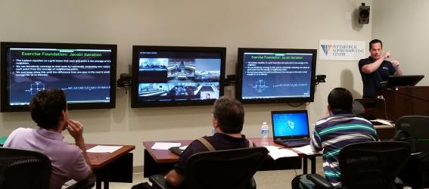
XSEDE Monthly Workshop Series
NSF Funded for the national scientific community
Wide Area Classroom (WAC) Format
Next OpenACC event is November 7th
Classroom based with 25 remote sites per event
50 events, 8000 students and counting
Contact Tom Maiden, tmaiden@psc.edu

Slide 34
Course Syllabus:
October 19: Introduction to OpenACC
October 26: GPU Programming with OpenACC
November 2: Optimizing and Best Practices for OpenACC
Questions? Email openacc@nvidia.com

