Slide 1
On-going efforts with open source compilers
Oscar Hernandez, Seeyong Lee
oscar@ornl.gov, lees2@ornl.gov
Oak Ridge National Laboratory
Sunita Chandrasekaran
University of Delaware
schandra@udel.edu
OpenACC Annual F2F Meeting
Sept 02-05, 2019
Kobe, Japan
This research used resources of the Oak Ridge Leadership Computing Facility at the Oak Ridge National Laboratory, which is supported by the Office of Science of the U.S. Department of Energy under Contract No. DE-AC05-00OR22725

Slide 2
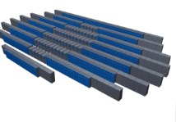



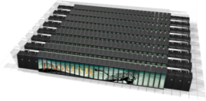


ORNL Path to Exascale
Since clock-rate scaling ended in 2003, HPC performance has been achieved through increased parallelism. Jaguar scaled to 300,000 CPU cores. | Titan and beyond deliver hierarchical parallelism with very powerful nodes. MPI plus node level parallelism through OpenACC and OpenMP
Jaguar: 2.3 PF
World’s Fastest
Titan: 27 PF
Accelerated Computing
World’s Fastest
Summit: 200 PF
Accelerated Computing
5–10× Titan Performance
Frontier: >1000 PF
Competitive Procurement
5-10× Summit Performance
2008
2012
2017
2021

Slide 3
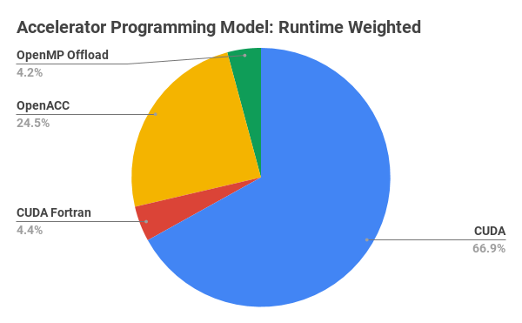
Accelerator Programming Models on Summit- 2019 INCITE
Programming model weighted by consumed-hours for INCITE up to June 2019
Source: XALT /Reuben Budiardja, NCCS
Notes:
GTC, CESM, Cgyro, GE, Turbulance GT, xmeshfem3d

Slide 4
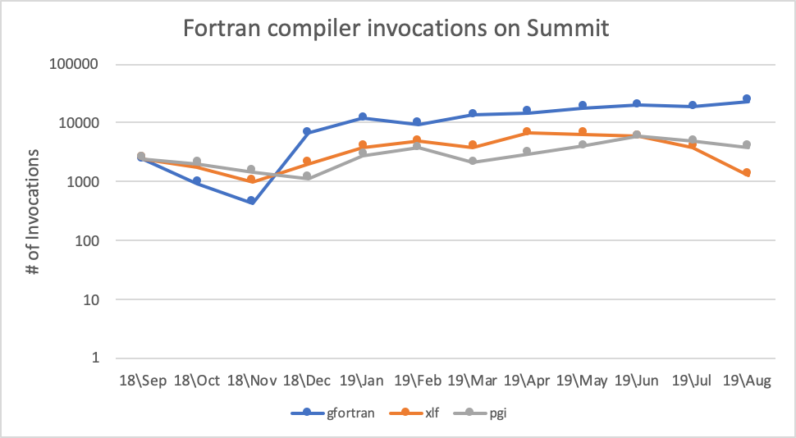
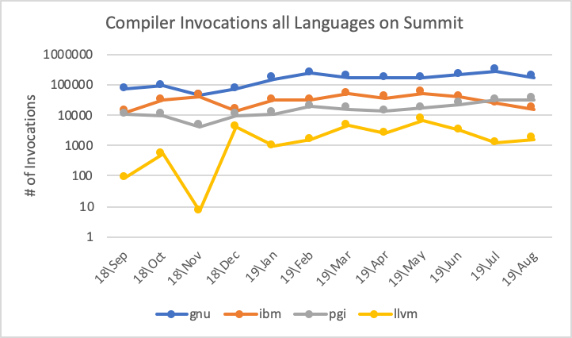
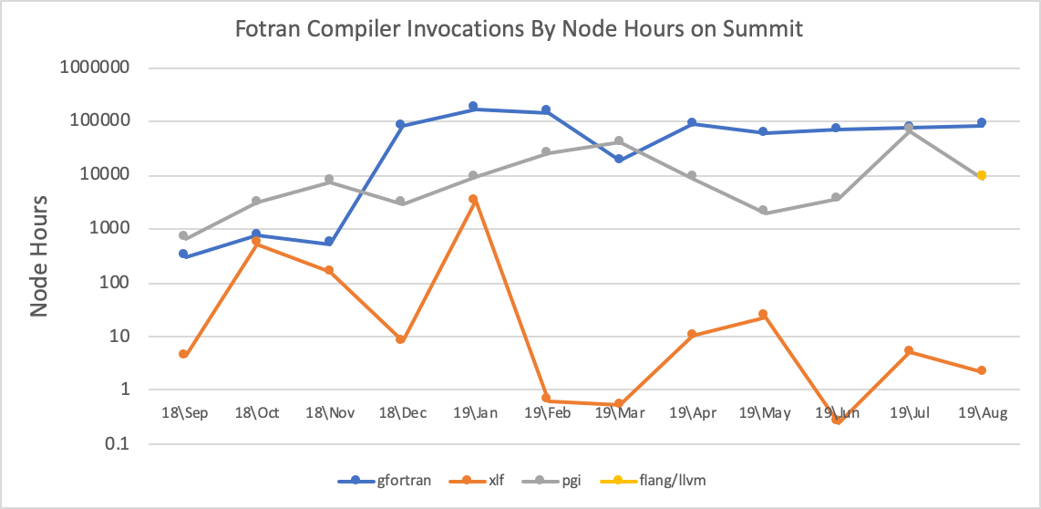
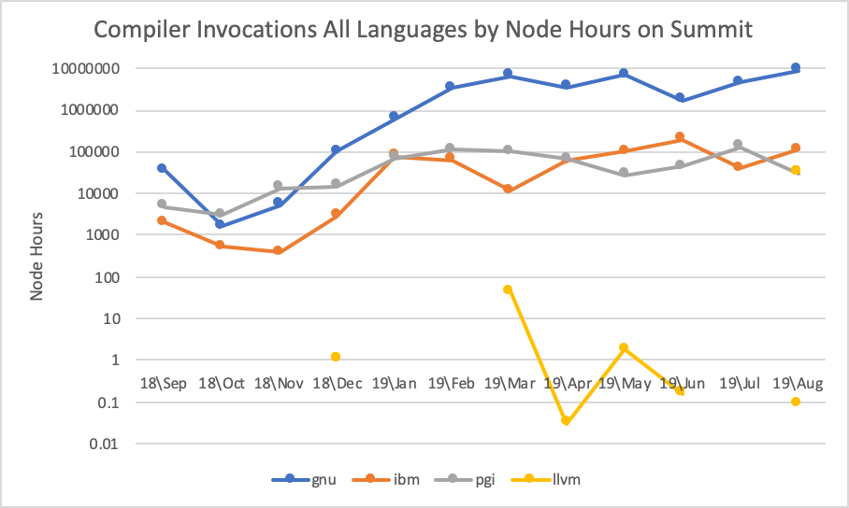
GNU compiler usage is growing Summit…
Source: XALT Database installed on Summit

Slide 5
Open-source OpenACC compilers
GCC is a very widely used compiler, at times the most frequently used compiler at HPC sites
Clacc is production compiler support for Clang and LLVM
OpenARC compiler from ORNL
Omni is a source-to-source compiler developed by
Verification and Validation Testsuite Project

Slide 6
Validation of OpenACC compilers
On-going Validation and Verification Testsuite project
https://github.com/OpenACCUserGroup/OpenACC-V
Tests available on GitHub for download and use
Feedback welcome: schandra@udel.edu
SPEC HPG ACCEL Benchmarks

Slide 7
HPG Benchmarks – SPEC ACCEL
SPEC Accel provides a comparative performance measure of
  Hardware accelerator devices (GPU, Co-processors, etc.)
  Supporting software tool chains (Compilers, Drivers, etc.)
  Host systems and accelerator interface (CPU, PCIe, etc.)
Computationally-intensive parallel HPC applications and mini-apps
Portable across multiple accelerators
Three distinct benchmarks, initially released in 2014, updated in 2017:
  OpenCL v1.1 19 C/C++ applications
  OpenACC v 1.0 15 Fortran/C applications
  OpenMP v4.5, 15 Fortran/C applications
Support for power measurement

Slide 8
Current GCC Status
Deployment at ORNL - Summit
  Official GCC9.1 (with NVPTX offloading Support)
  openacc-gcc-9-branch (features being merged into GCC 10.0)
NVPTX OpenACC 2.6 + performance improvements
  Being merged into GCC Trunk – targeting GCC 10.0
Significant performance is needed for loop optimization.

Slide 9
Status of OpenACC and OpenMP compilers on Summit
 | Open ACC |  |  |  |  |  |  |  |  |  | OpenMP
 |  |  |  |  | GNU 9.1.0 |  |  | PGI 19.5 |  |  |  |  |  |  | GNU 9.1.0 |  |  | XL 16.1.1-3
 | Benchmark |  | Reference time |  | Pass/Fail |  |  | Time |  |  | Benchmark |  | Reference time |  | Pass/Fail |  |  | Time
ostencil | 303.ostencil |  | 145 |  |  |  |  | 12.1 |  |  | 503.postencil |  | 109 |  |  |  |  | 10.2
olbm | 304.olbm |  | 455 |  |  |  |  | 36.3 |  |  | 504.polbm |  | 122 |  |  |  |  | 19.9
omriq | 314.omriq |  | 956 |  |  |  |  | 35.5 |  |  | 514.pomriq |  | 621 |  |  |  |  | 45.5
md | 350.md |  | 252 |  |  |  |  | 9.28 |  |  | 550.pmd |  | 241 |  |  |  |  | 21.2
palm | 351.palm |  | 370 |  |  |  |  | 117 |  |  | 551.ppalm |  | 544 |  |  |  |  | 203
ep | 352.ep |  | 530 |  |  |  |  | 45.8 |  |  | 552.pep |  | 231 |  |  |  |  | 179
clvrleaf | 353.clvrleaf |  | 445 |  |  |  |  | 35.9 |  |  | 553.pclvrleaf |  | 1145 |  |  |  |  | 55.5
cg | 354.cg |  | 408 |  |  |  |  | 31.2 |  |  | 554.pcg |  | 333 |  |  |  |  | 72.8
seismic | 355.seismic |  | 370 |  |  |  |  | 26 |  |  | 555.pseismic |  | 282 |  |  |  |  | 45.8
sp | 356.sp |  | 276 |  |  |  |  | 21.6 |  |  | 556.psp |  | 818 |  |  |  |  | 29.3
csp | 357.csp |  | 270 |  |  |  |  | 19.5 |  |  | 557.pcsp |  | 859 |  |  |  |  | 92.4
miniGhost | 359.miniGhost |  | 369 |  |  |  |  | 35.8 |  |  | 559.pmniGhost |  | 397 |  |  |  |  | 41.5
ilbdc | 360.ilbdc |  | 367 |  |  |  |  | 27.3 |  |  | 560.pilbdc |  | 653 |  |  |  |  | 30.5
swim | 363.swim |  | 230 |  |  |  |  | 34.2 |  |  | 563.pswim |  | 159 |  |  |  |  | 28
bt | 370.bt |  | 223 |  |  |  |  | 9.37 |  |  | 570.pbt |  | 780 |  |  |  |  | 75.7
Unofficial SPEC ACCEL 1.2 results – Academic use

Slide 10
Going Forward
https://procurement.ornl.gov/rfp/6400016227/
  Solicitation No. 6400016227 : GNU Compiler Collection
“The primary purpose of this Statement of Work (SOW) is to bring the implementations of OpenACC and OpenMP in the GCC compiler suite up to the latest versions of the standards, and supporting the GPU-accelerators of interest to OLCF so that it becomes fully capable with respect to the needs of OLCF users on OLCF and other platforms.”
“The expectation is that this work will be completed as quickly as reasonably possible, but definitely prior to April 2022, in anticipation of the upcoming delivery of the new Frontier system.“
RFP Contact information: William Besancenez {Willy} besancenezwr@ornl.gov

Slide 11
GCC OpenACC: Current Status
Mainline GCC Upstreaming
  100+ patches committed for GCC 9
  Remaining local patches + OpenACC 2.6 planned for GCC 10
Performance Improvements
  LSDalton, RayTrace, Helmholtz optimized, SPEC ACCEL in the process
  LSDalton 2-3% faster than PGI
OpenACC support status
  OpenACC 2.6 compliant
  AMD GCN and NVIDIA PTX support
Notes:
Application-driven performance improvements:
Performance improvements under SOW-10
RayTrace: 72% improvement GCC8->GCC9 on Power9 + Volta
Helmholtz: 5% improvement GCC8->GCC9 on Power9 + Volta
Matrix Multiply: 262x speedup GCC8->GCC9 for 2000x2000 kernel implementation

Slide 12
GCC OpenACC: Current Status
GCC OpenACC 2.6 support added to GCC for NVIDIA PTX and AMD GCN platforms
  Available in development branch of GCC 8, GCC 9 in May of 2019
  Subset up-streamed to GCC 9 mainline
Mainline adoption of OpenACC for GCC
  Wider availability as Linux vendors move to GCC 9
SPEC ACCEL results: early stages

Slide 13
GCC OpenACC: Work in progress..
Performance Gaps
  Kernel Regions: Requires for seamless performance improvement
  Automatic addition of loop directives within kernel regions
  Loop analysis, reduction issues, privatization
  SPEC ACCEL underperforming PGI
  AMD GCN performance not yet evaluated

Slide 14
GCC OpenACC: Work in progress…
OpenACC specification implementation gaps:
  OpenACC 2.7 (including Multicore CPU support)
  OpenACC 2.8 expected Fall 2019
  OpenMP and OpenACC interoperability
  Nested parallelism not supported
  Data clause combinations not well-tested (ie. dynamic arrays with private clauses)
  Further details here https://gcc.gnu.org/wiki/OpenACC#Known_Issues

Slide 15

Clacc: Open source production OpenACC Compiler Ecosystem
Exascale Computing Project (ECP) Funded (STTO12-PROTEAS)
  Provide productive and performance-portable programming solutions based on directive-based methodologies that support current language paradigms
Principal Investigator: Jeff Vetter, Oak Ridge National Laboratory
Team Members: Joel Denny & Seyong Lee, Oak Ridge National Laboratory

Slide 16
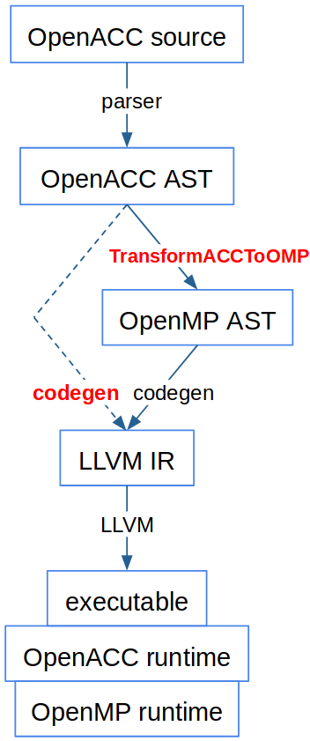
Clacc Compiler Ecosystem
Objective(s)
  Clacc: OpenACC support for Clang and LLVM
  Contribute production-quality, standard-conforming traditional OpenACC compiler and runtime support
    Leverage Clang/LLVM ecosystem extensibility
    E.g., Pretty printers, analyzers, lint tools, and debugger and editor extensions
    Actively contribute OpenACC support to upstream Clang and LLVM
  Target other OpenMP compilers besides upstream Clang, including forks of Clang targeting other accelerator architectures
Notes:
including forks of Clang targeting other accelerator architectures = AOMP compiler but Joel said it is not official and he is hesitant to be explicit as they have not started to pursue it, so better to keep it generic

Slide 17
Clacc’s Design
Build a traditional OpenACC compiler
  Fully parse and validate OpenACC
  Not expose OpenMP diagnostics, debugging symbols to users
Translate OpenACC to OpenMP
  OpenACC is descriptive; OpenMP is prescriptive
  Deeper analysis required; a 1-1 mapping will not suffice
  Translate (lower) OpenACC to OpenMP using LLVM IR analyses
  Apply OpenMP source-level tools to OpenACC
  LLVM IR parallel extensions in the future
Notes:
Source-to-source translation Automatic migration to OpenMP
Maximize OpenMP implementation reuse: AST transformation

Slide 18
Clacc Roadmap
2019 and earlier
Focus on C
Focus on behavioral correctness
Prescriptive OpenACC interpretation
Many-to-one mapping to OpenMP
Propose fixes to OpenACC spec
Upstreaming mutually beneficial improvements to Clang and LLVM
2020 and later
Extend to C++
Focus on performance
Descriptive OpenACC interpretation
Analyses for best mapping to OpenMP
Investigate advanced LLVM analyses (e.g., autotuning, polly, LLVM IR extensions)
Upstreaming OpenACC support
Funded via ECP Proteas project

Slide 19
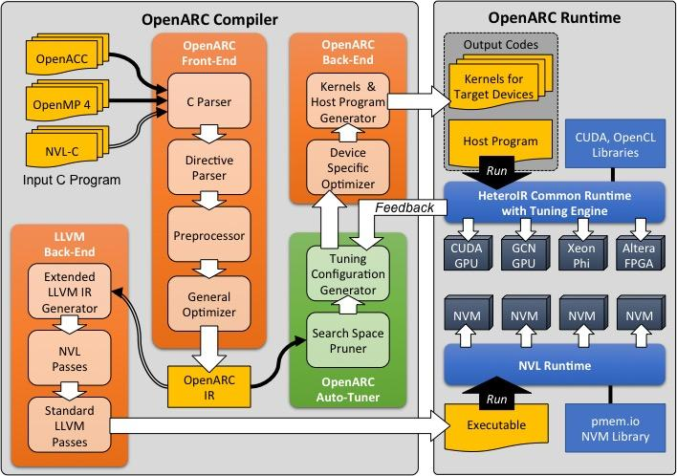
OpenARC: Open Accelerator Research Compiler
Perform source-to-source translation from OpenACC C to architecture-independent high-level representation (HeteroIR)
Support CUDA/OpenCL back ends
Support features of OpenACC V2.0 (and subsets of V2.5)
Built-in tuning tools to control overall translation

Slide 20
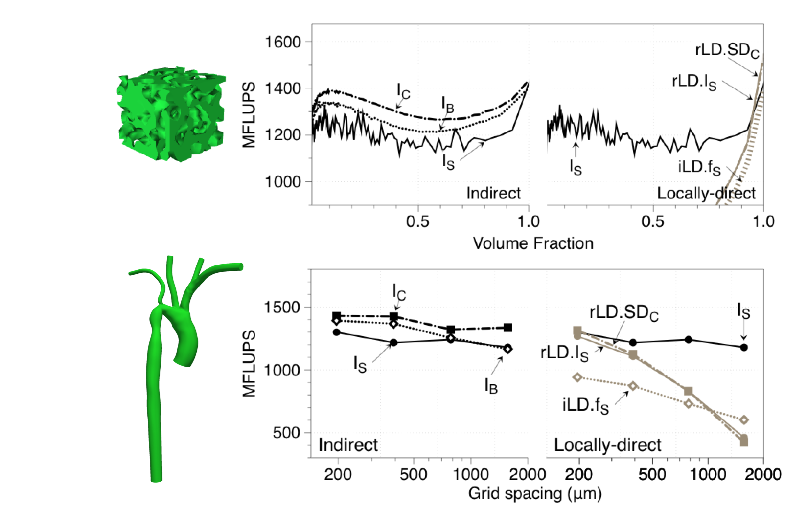
Using OpenARC: Performance Portability Study for Massively Parallel Computational Fluid Dynamics Application
Problem
  A critical unmet need to improve the performance portability of large fluid dynamic applications and enable such codes to run efficiently on a wide range of hardware with minimal efforts.
Solution
  Presents a case study in performance portability of HARVEY, a massively parallel computational fluid dynamics, that assesses
    1) performance portability seen when simulating blood flow in three different vascular regions on diverse heterogeneous architectures;
    2) model-based performance prediction for future architectures; and
    3) performance scaling of the hybrid MPI+X programming on parallel heterogeneous systems.
Seyong Lee, et. al., Performance Portability Study for Massively Parallel Computational Dynamics Application on Scalable Heterogeneous Architectures, Journal of Parallel and Distributed Computing (JPDC) Vol. 129 P1-13, 2019.

Slide 21
OpenARC Roadmap
2019 and earlier
  Support basic translation from OpenMP4 to OpenACC and vice versa.
  Enable interoperability between OpenACC and OpenMP4.
  Add FPGA-specific directive extensions and related optimizations.
2020 and later
  Optimize interoperability between OpenACC and OpenMP4.
  Extend OpenARC compiler and runtime to support multiple, different heterogeneous devices in a single node.
  Support full features of OpenACC V2.5 and later.

Slide 22
Preliminary Evaluation
Clacc status: C, prescriptive interpretation, multicore
Ubuntu 18.04, 32GB DRAM
Intel core i7-7700HQ, 2.8GHz CPU, 8 threads
NVIDIA GeForce GTX 1050
PGI 18.4
SPEC ACCEL 1.2, ref workload, non-compliant

Slide 23
Thermodynamics benchmark solving PDE
Notes:
303.ostencil is a thermodynamics benchmark solving partial differential equations (PDE) using a stencil code on a 3-D structured grid. pgcc offers a substantial performance improvement when moving offloading from host to multicore. Clacc offers a modest improvement for the same move, but it’s small enough that it might be just OS noise. However, under the “multicore clacc gwv” configuration, Clacc is comparable with pgcc on multicore and improves significantly over Clacc’s host performance. Interestingly, this configuration merely adds a single worker clause to a single gang loop that already has a nested vector loop. Another interesting point here is that attempting to compile Clacc’s OpenMP output with pgcc gives significantly worse performance than either compiler does for host. On the other hand, pgcc offloading to GPU is far better than all other test configurations

Slide 24
CFD benchmark implementing LBM
Notes:
304.olbm is a computational fluid dynamics benchmark implementing the Lattice Boltzmann Method (LBM) and simulating incompressible fluids in 3D. pgcc offloading to GPU clearly outperforms the other test configurations for this benchmark. Otherwise, due to the aforementioned OS noise, we are not convinced the small differences in the various durations here are representative of important differences among the test configurations. It’s no surprise that Clacc offloading to multicore fails to see a significant improvement over Clacc for host because 304.olbm specifies all acc loop directives without gang, worker, or vector clauses, so Clacc treats them as sequential loops. However, after we add those clauses, Clacc does not produce better performance, and pgcc, which applies the power of pgcc’s descriptive interpretation of OpenACC, does no better either. We noticed that compilation for “multicore clacc gwv” warned of a failure to vectorize. We tried passing -Minfo to pgcc when offloading to multicore and found that then it too reported that, due to a data dependency, it was unable to vectorize each loop marked with acc loop in 304.olbm. However, when we offload to the GPU, pgcc reports successful vectorization.

Slide 25
XcalableACC (XACC)
A new programming model for accelerated clusters
  To reduce programming cost
  Directive-based language extension based on C and Fortran (C++ on the table)
  Multi-level parallelism (inter-node/intra-node/accelerators)
Omni Compiler
  Open source software
  Source-to-source compiler for directive-based languages
  Support XMP, XACC, OpenACC directives
  Any OpenACC compiler can be used as a backend compiler
https://pdfs.semanticscholar.org/8988/4d42ce11262649013b7c0cc49004f746c3ef.pdf

Slide 26
Evolution of OpenACC: Future Path Forward
Discuss future directions with new members (Riken, CSCS/ETH, NERSC/LBL)
Support for other diverse architectures such as FPGAs
Relationship of directives with new emerging frameworks (e.g. Kokkos for C++)
Adoption of parallel constructs into base language standards

Slide 27
OpenACC Support for ARM
Roadmap
  PGI-OpenACC support for ARM
  ETA alpha/beta release may be end of 2019

Slide 28
Validation of OpenACC compilers
On-going Validation and Verification Testsuite project
https://github.com/OpenACCUserGroup/OpenACC-V
Tests available on GitHub for download and use
Feedback welcome: schandra@udel.edu
Results
  GCC 9.1.0 (the most latest drop on Summit)
    PASS = 539, FAIL = 276 (CE = 206 ; RE = 70 ) – 66% PASS
    file:///Users/oh7/Documents/OpenACC_VV_Results/results_template/results.html
  PGI 19.7
  file:///Users/oh7/Documents/OpenACC_VV_Results_PGI/results_template/results.html

Slide 29
PGI Strengths and Weaknesses
Strengths
  Most mature OpenACC implementation.
  Informational feedback messages from compiler can help code development and porting.
  Lots of features: CUDA interoperability, auto-compare CPU/GPU, CUDA managed memory support, unified binary to support multiple GPU types, initial deep copy.
Weaknesses
  Does a lot of implicit parallelization and data movement (promoting user laziness), which means programs that work well with the PGI compilers may not work so well with other compilers.
  Device-side language features/limitations are not well-documented, and error messages are not always helpful.
  Only supports NVIDIA GPUs and multicore CPUs.

Slide 30
GCC Strengths and Weaknesses
Strengths
  Freely available toolchain targeting AMD accelerators available from Mentor website (and soon, openacc.org)
  AMD and NVIDIA toolchains converging on common codebase allowing both toolchains to share improvements and remain source compatible
  Ongoing OSS community development efforts and bug fixing
Weaknesses
  NVIDIA toolchain must be built from source; downloadable version not available
  Kernels directive performance ongoing issue; more improvements planned in 2020
  GCC OpenACC 2.6 not integrated into GCC mainline; planned for 2020

Slide 31
Clacc Strengths and Weaknesses
Strengths
  Builds on the extensible, production-quality, open-source Clang and LLVM compiler ecosystem.
  Supports full compilation of OpenACC as well as source translation to OpenMP.
  Design reuses rather than replicates capabilities of Clang's OpenMP implementation.
Weaknesses
  Not yet ready for production use.

Slide 32
Directives – what the community needs…
Quality of implementations – full standard support
Develop long term strategies… requirements to base languages
Interoperability with other PM (e.g. HIP, MPI, scientific libraries)
Tasking important to orchestrate work across accelerators, network and multi-cores
  Coarse grain asynchronous execution is extremely important across devices
Consistent implementations across compilers & architectures
Translation strategies between OpenMP and OpenACC
  Both ways
Common Runtimes for accelerators
  GOMP, LLVM community, etc

